Slide 1
XSLT Web Part & Data View Web Part
Notes:
Working with and collaborating on data is an essential part of SharePoint 2010. To facilitate the collaboration, Lists and Libraries are utilized heavily in SharePoint. SharePoint Designer 2010 can be used to customize the view of that data to conform to user needs. Aside from manipulating the presentation of SharePoint data, SharePoint Designer can also make connections to and present data from external data sources such as databases and web services. In this module, you will learn how to use SharePoint Designer to work with internal and external data sources.

Slide 2
Agenda
XSLT Data View and Data Form Web Parts
Introducing the XSLT List View Web Part
XSLT List View vs. Data View Web Parts
Exploring the List View Tools
Working with the XPath Editor

Slide 3
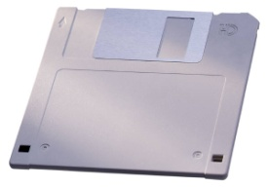


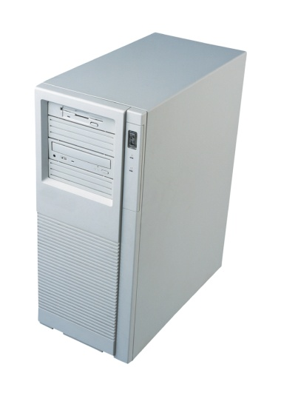
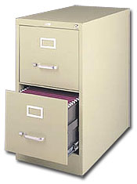
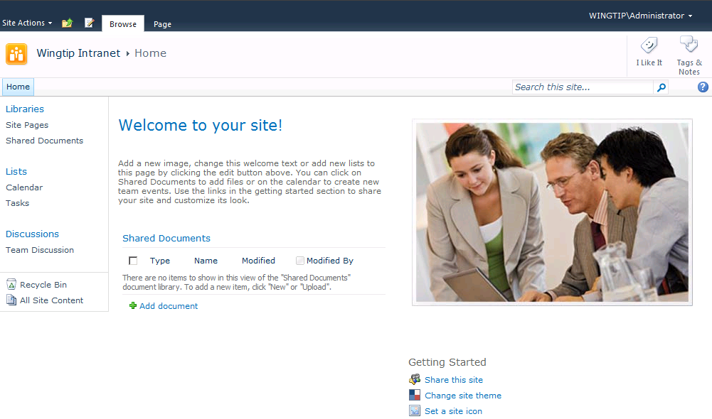
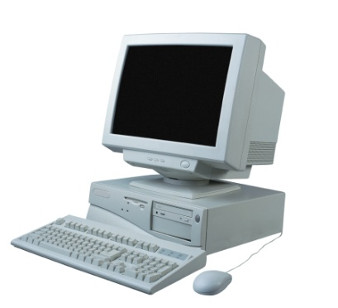

Displaying Content is What It’s All About!
Notes:
Ask anyone running a SharePoint site and they will tell you how important it is for them to display a variety of data in their SharePoint sites.
There are many ways to get to the data. The most prevalent one is by using Visual Studio to programmatically get access to the data and bring it into SharePoint. This requires knowledge of managed code (C#, VB etc). This module will show how there is an easier way to get to the same data without having to program – XSLT Web Parts using SharePoint Designer 2010.

Slide 4
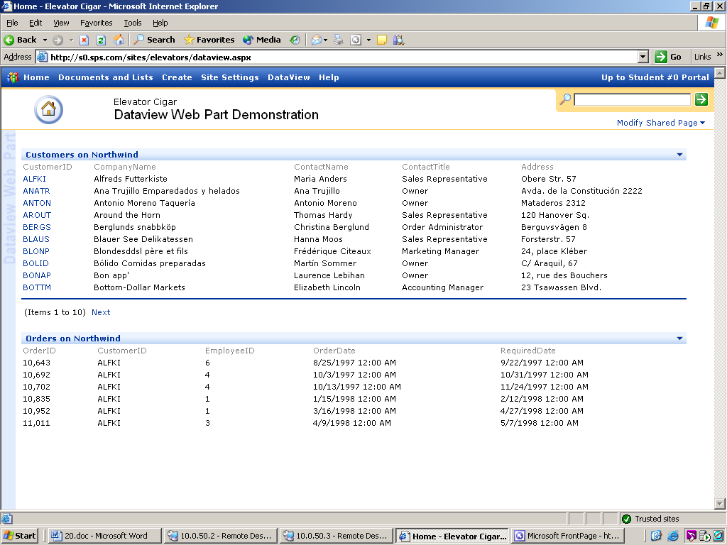
Origins of XSLT Data View Web Part
XSLT Data View Web Part lets you get to your data from a variety of places
Has been available since the release of FrontPage 2003 with read-only capability
Notes:
The XSLT Data View Web Part has been pretty unknown to many through the years. However, it has been around since the FrontPage 2003 days. This Web Part uses XML and XSLT (extensible language transformation) to fetch and then display custom formatted data from a variety of sources (lists, libraries, databases, Web services and more).

Slide 5
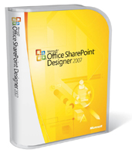
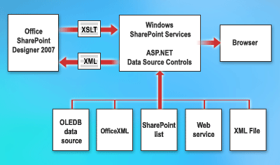
XSLT Data Form Web Part Introduced in SharePoint Designer 2007
XSLT Data Form Web Part is the evolution of XSLT Data View Web Part
Lets you read & write data back to data sources
Notes:
Data Form Web Part is sometimes refer to as the ‘Swiss Army Knife’ of Web Parts. It is very versatile and extremely powerful. Building on the functionality that shipped with FrontPage 2003, this Web Part lets you write data back to the data source.

Slide 6
Agenda
XSLT Data View and Data Form Web Parts
Introducing the XSLT List View Web Part
XSLT List View vs. Data View Web Parts
Exploring the List View Tools
Working with the XPath Editor

Slide 7
Introducing XSLT List View Web Part
Replaces List View Web Part
Web 2.0 View Framework
Schema agnostic
Better User Experience
In-Place Editing
BaseXsltData WebPart
DataForm WebPart (V3)
BaseXsltList WebPart (v4)
DataView WebPart (V2)
XsltListForm WebPart (V4)
XsltListView WebPart (V4)
WebPart
ListForm WebPart
ListView WebPart
Notes:
SharePoint has two types of viewing demands. Viewing interactive forms for editing list items, and viewing lists of items. For each of these demands there have been a variety of technologies that have seen the light of day. SharePoint 2003 introduced basic interaction through the List Form, List View and Data View. SharePoint 2007 came with the Data Form Web Part (commonly referred to as Data-View).
The new view technology to discuss is the XSLT List View Web Part. It provides benefits across the board. By making use and building upon the rich features of the Data-View but making it more generic, SharePoint 2010 has a higher ability for re-use and lowers the bar for custom development.

Slide 8
Inside the XSLT List View Web Part
Xml Definition
CAML Query
Data Source
XML Data
XSLT List View Web Part
List Name
List Schema
HTML
XSL Compiled Transform
XSL
View Transform
Notes:
The XSLT List View Web Part generally takes the same approach as a normal data view. However, since the XSLT is now schema-agnostic, you need to pass in the schema as a separate parameter and no longer pass this information as content of the view.

Slide 9
SharePoint Development Platform
SharePoint Server Capabilities
Content
Search
Compositions
Insights
Sites
Communities
Pages and User Interface
Web UI
Framework
Web Parts
ASP.NET forms
Silverlight
XSLT Views
Server APIs
Connected Client APIs
Event Model
LINQ
Web Services
REST
Client OM
Application Model (Sites)
Application Lifecycle
Data Model Lists
Content Management
File System
Content Types
Solutions
Lists
Library Features
Templates
New
Improved
External Lists
Workflow
Features
Query

Slide 10
DEMO
XSLT List View Web Part

Slide 11
Agenda
XSLT Data View and Data Form Web Parts
Introducing the XSLT List View Web Part
XSLT List View vs. Data View Web Parts
Exploring the List View Tools
Working with the XPath Editor

Slide 12
Comparing View Technologies
 | 2003 | 2007 | 2007 | 2010
 | List View | List Form | Data Form | XSLT List View
Rendering Technology | CAML | ASP.NET | XSLT | XSLT
Render Lists | X |  | X | X
Render Items |  | X | X | X
Aggregate Data |  |  | X | X
Render External Data |  |  | X | X
Browser Editing | X | X |  | X
SPD Editing |  |  | X | X
Parameterizable |  |  | X | X
Conditional Formatting, High customizability |  |  | X | X
Performance | X | X |  | X
Notes:
This slide discusses some of the differences between the prevailing view technologies in SharePoint. Especially the difference in technology used to render content (CAML / ASP.NET or XSLT) is a big difference between these Web Parts.

Slide 13
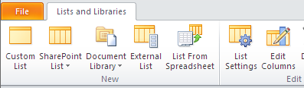
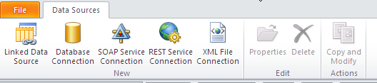
XSLT List View vs. XSLT Data View
XSLT List View lets you get to Lists and Libraries
XSLT Data View lets you get to a variety of data sources
Notes:
XSLT List View and Data View are pretty similar in nature. Both of them make use XML when retrieving and storing data from a resource. List view Web Parts are prevalent all through SharePoint already. The view pages of all lists and libraries contain list view Web Parts which can be easily customized using the SPD UI.
The major difference between the two Web Parts is the ability to get to data:
List Web Parts are scoped only to access data from lists and libraries.
Data View Web Parts can access data from lists, libraries and external sources (databases, Web services, XML files).

Slide 14
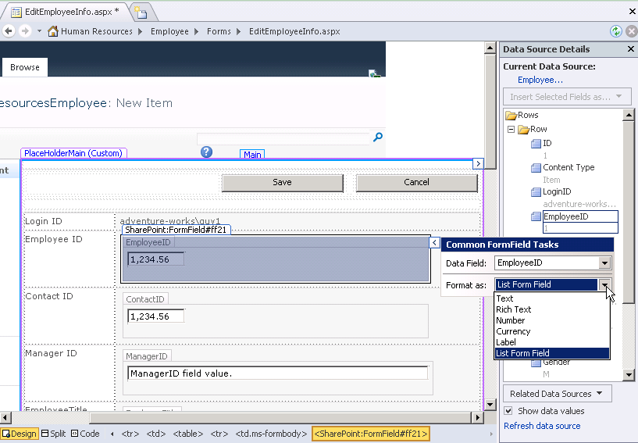
Manipulating Data in XSLT Web Parts
Easily change formatting of displayed data at the field level
Notes:
The XSLT List View and Data View Web Parts provide the facility to manipulate each data point at a very granular level (the customization that’s performed is only for the display of the data and does not affect the original data source). Each form field can be formatted to many other data types (text, number, currency etc).

Slide 15
Agenda
XSLT Data View and Data Form Web Parts
Introducing the XSLT List View Web Part
XSLT List View vs. Data View Web Parts
Exploring the List View Tools
Working with the XPath Editor

Slide 16
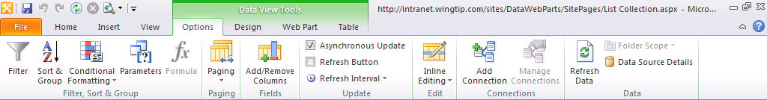
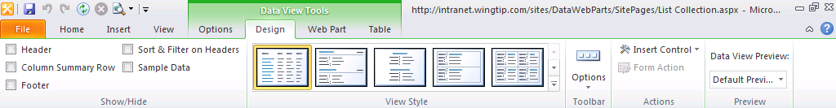
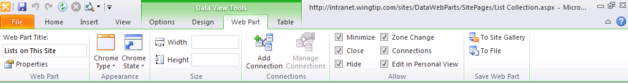
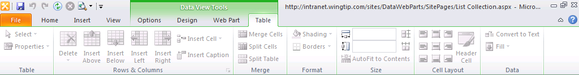
List View Tools in the Ribbon
List View Tools let you customize the List View Web Part
Notes:
When the focus is on a List View Web Part, the ribbon shows the actions you can perform on it.
There are 4 tabs that appear within List View Tools:
Options: Data manipulation such as adding/removing columns, pagination and conditional formatting are available here.
Design: The style and design of the Web Part can be changed using this tab.
Web Part: General Web Part properties.
Table: Since the XSLT List View Web Part is deployed using a table, the table manipulation options are available here.

Slide 17
DEMO
Working with existing List View Web Parts
Notes:
Show code behind of list view
Working with List View tools
Changing formatting of data points

Slide 18
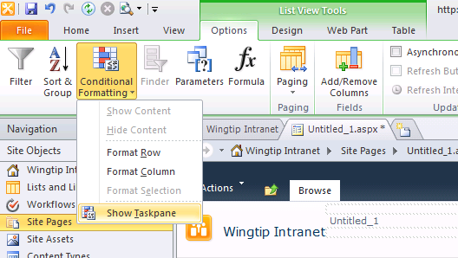
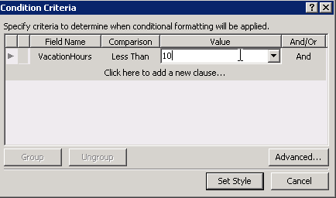
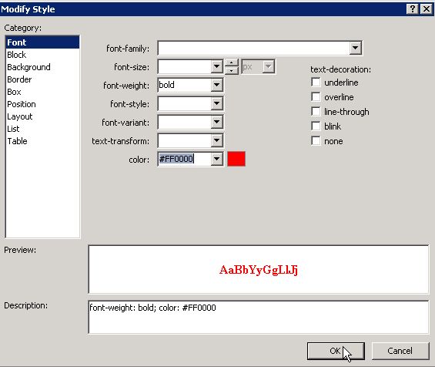
Conditional Formatting
Notes:
Conditional formatting is used to format data based on a condition criteria. It can be used to change the style of cells, rows or the entire column. In addition to changing display styles, conditional formatting rules can be used to display or hide data as well.

Slide 19
Agenda
XSLT Data View and Data Form Web Parts
Introducing the XSLT List View Web Part
XSLT List View vs. Data View Web Parts
Exploring the List View Tools
Working with the XPath Editor

Slide 20
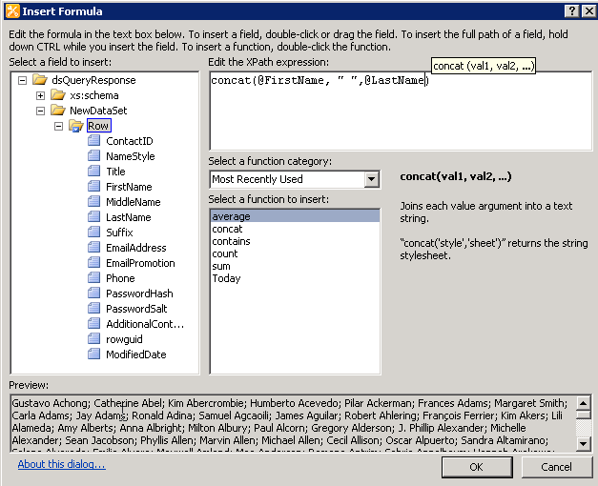
XPath Editor
XPath is a language used to query XML data
XPath editor is built into SPD 2010 to manage XPath expressions
Notes:
Under the covers, the rules for conditional formatting and general data manipulation are created using XML Path Language (XPath). XPath is a language used for locating and processing information within XML.
The XPath editor ships with SharePoint Designer. Alongside the XML data that your query returns, you also have access to many functions to manipulate XML data at a very granular level.

Slide 21
DEMO
Formatting List View Web Parts

Slide 22
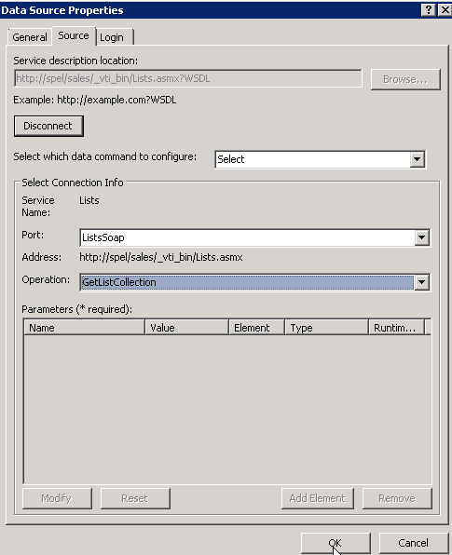
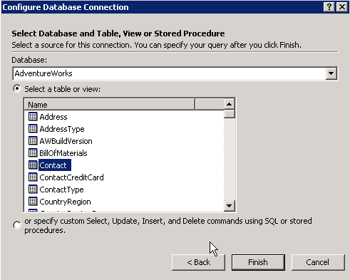
Connecting to External Sources
Data connection wizards for Databases and Web Services
Notes:
Connecting to external sources of data is easy using SharePoint Designer. SPD provides wizards to connect to all sorts of data within and outside of your organization. While making the connection, you can also provide login credentials for the source.
In addition to connecting to individual data sources, you can also link data sources together using fields that contain similar data.

Slide 23
DEMO
Connecting to External Sources of Data

Slide 24
Summary
XSLT Data View and Data Form Web Parts
Introducing the XSLT List View Web Part
XSLT List View vs. Data View Web Parts
Exploring the List View Tools
Working with the XPath Editor

